Slide 1
Credit card fraud
By: Cody Lerch, Debasis Pradhan, Elena Gehle, Isaac Fonseca, and Warren Simmons

Slide 2
Analysis report of credit card fraud
Summary
This report presents an analysis of credit card fraud.
xxxxxxxx
60% of U.S. credit card holders have been victimized by fraud, and 45% have experienced fraud multiple times.
52 million Americans had fraudulent charges on their credit or debit cards last year, with unauthorized purchases exceeding $5 billion.
The median fraudulent charge also jumped 26% in the last two years, rising from $79 to $100.
Only 7% of fraudulent charges involved stolen or lost credit cards; the rest accessed personal data and account information remotely.
Four of five cardholders admit to at least one risky credit card habit, making their accounts more vulnerable to fraud.
Research Question
xxxxxxxx

Slide 3
Cleaning procedure

Slide 4
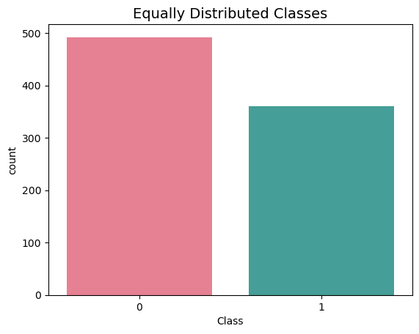
distribution of sub sample classes
0 0.577465
1 0.422535

Slide 5
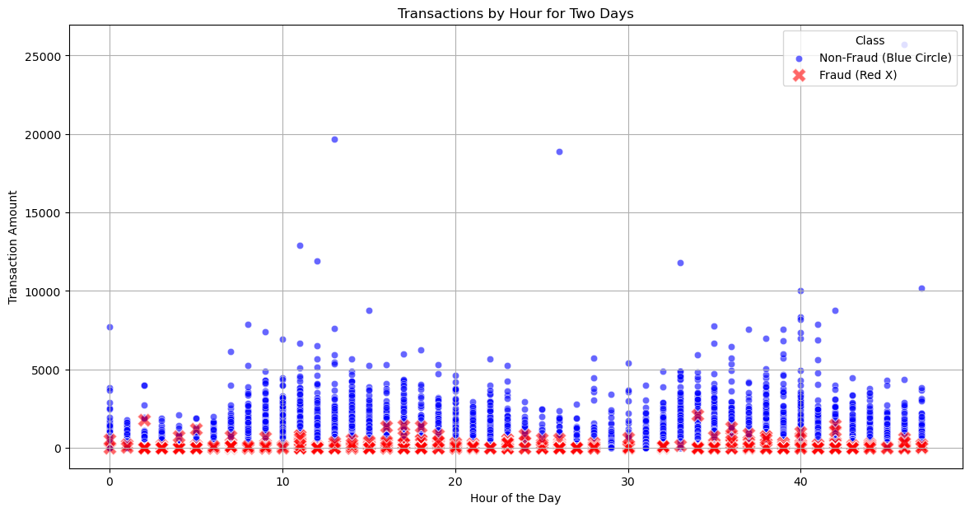
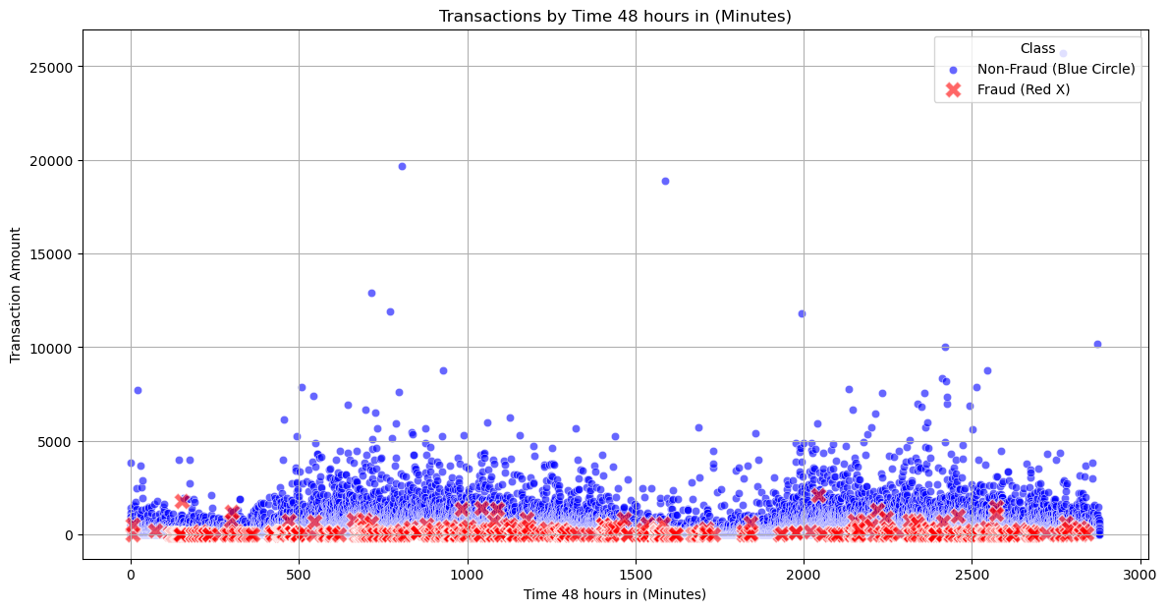
scatter plot by hour and minute

Slide 6
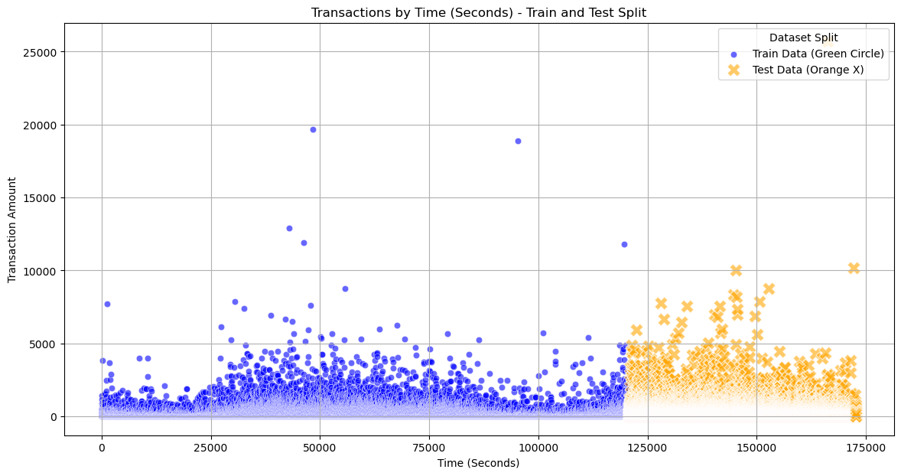
train and test split

Slide 7
Predictive Models considered
Logistic Regression
Decision Tree: DecisionTreeClassifier

Slide 8
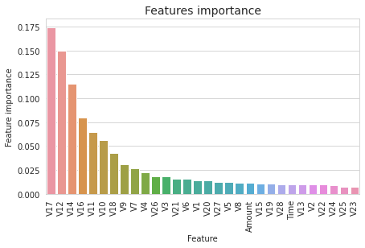
Predictive Models considered
Random Forest: RandomForestClassifier
Gradient Boosting: GradientBoostingClassifier
The most important features are V17, V12, V14, V10, V11, V16.

Slide 9
Predictive Models considered
Support Vector Machine: SVC
ExtraTreesClassifier:

Slide 10
Predictive Models considered
KNN: KNeighborsClassifier

Slide 11
Credit card fraud Trends

Slide 12
Executive Summary

Slide 13
references
1). Gabriel Preda (2024) Credit Card Fraud Detection Predictive Models. https://www.kaggle.com/code/gpreda/credit-card-fraud-detection-predictive-models
2). Brett Cruz(2024, Jul 26) 52 Million Americans Experienced Credit Card Fraud Last Year. Securiety.org
3). RandomForrestClassifier, http://scikit-learn.org/stable/modules/generated/sklearn.ensemble.RandomForestClassifier.html

